Slide 1
Database Systems
Lecture 19
Relational Algebra

Slide 2
Today’s agenda
Example Database Application (COMPANY)
Relational Algebra
Unary Relational Operations
Relational Algebra Operations From Set Theory

Slide 3
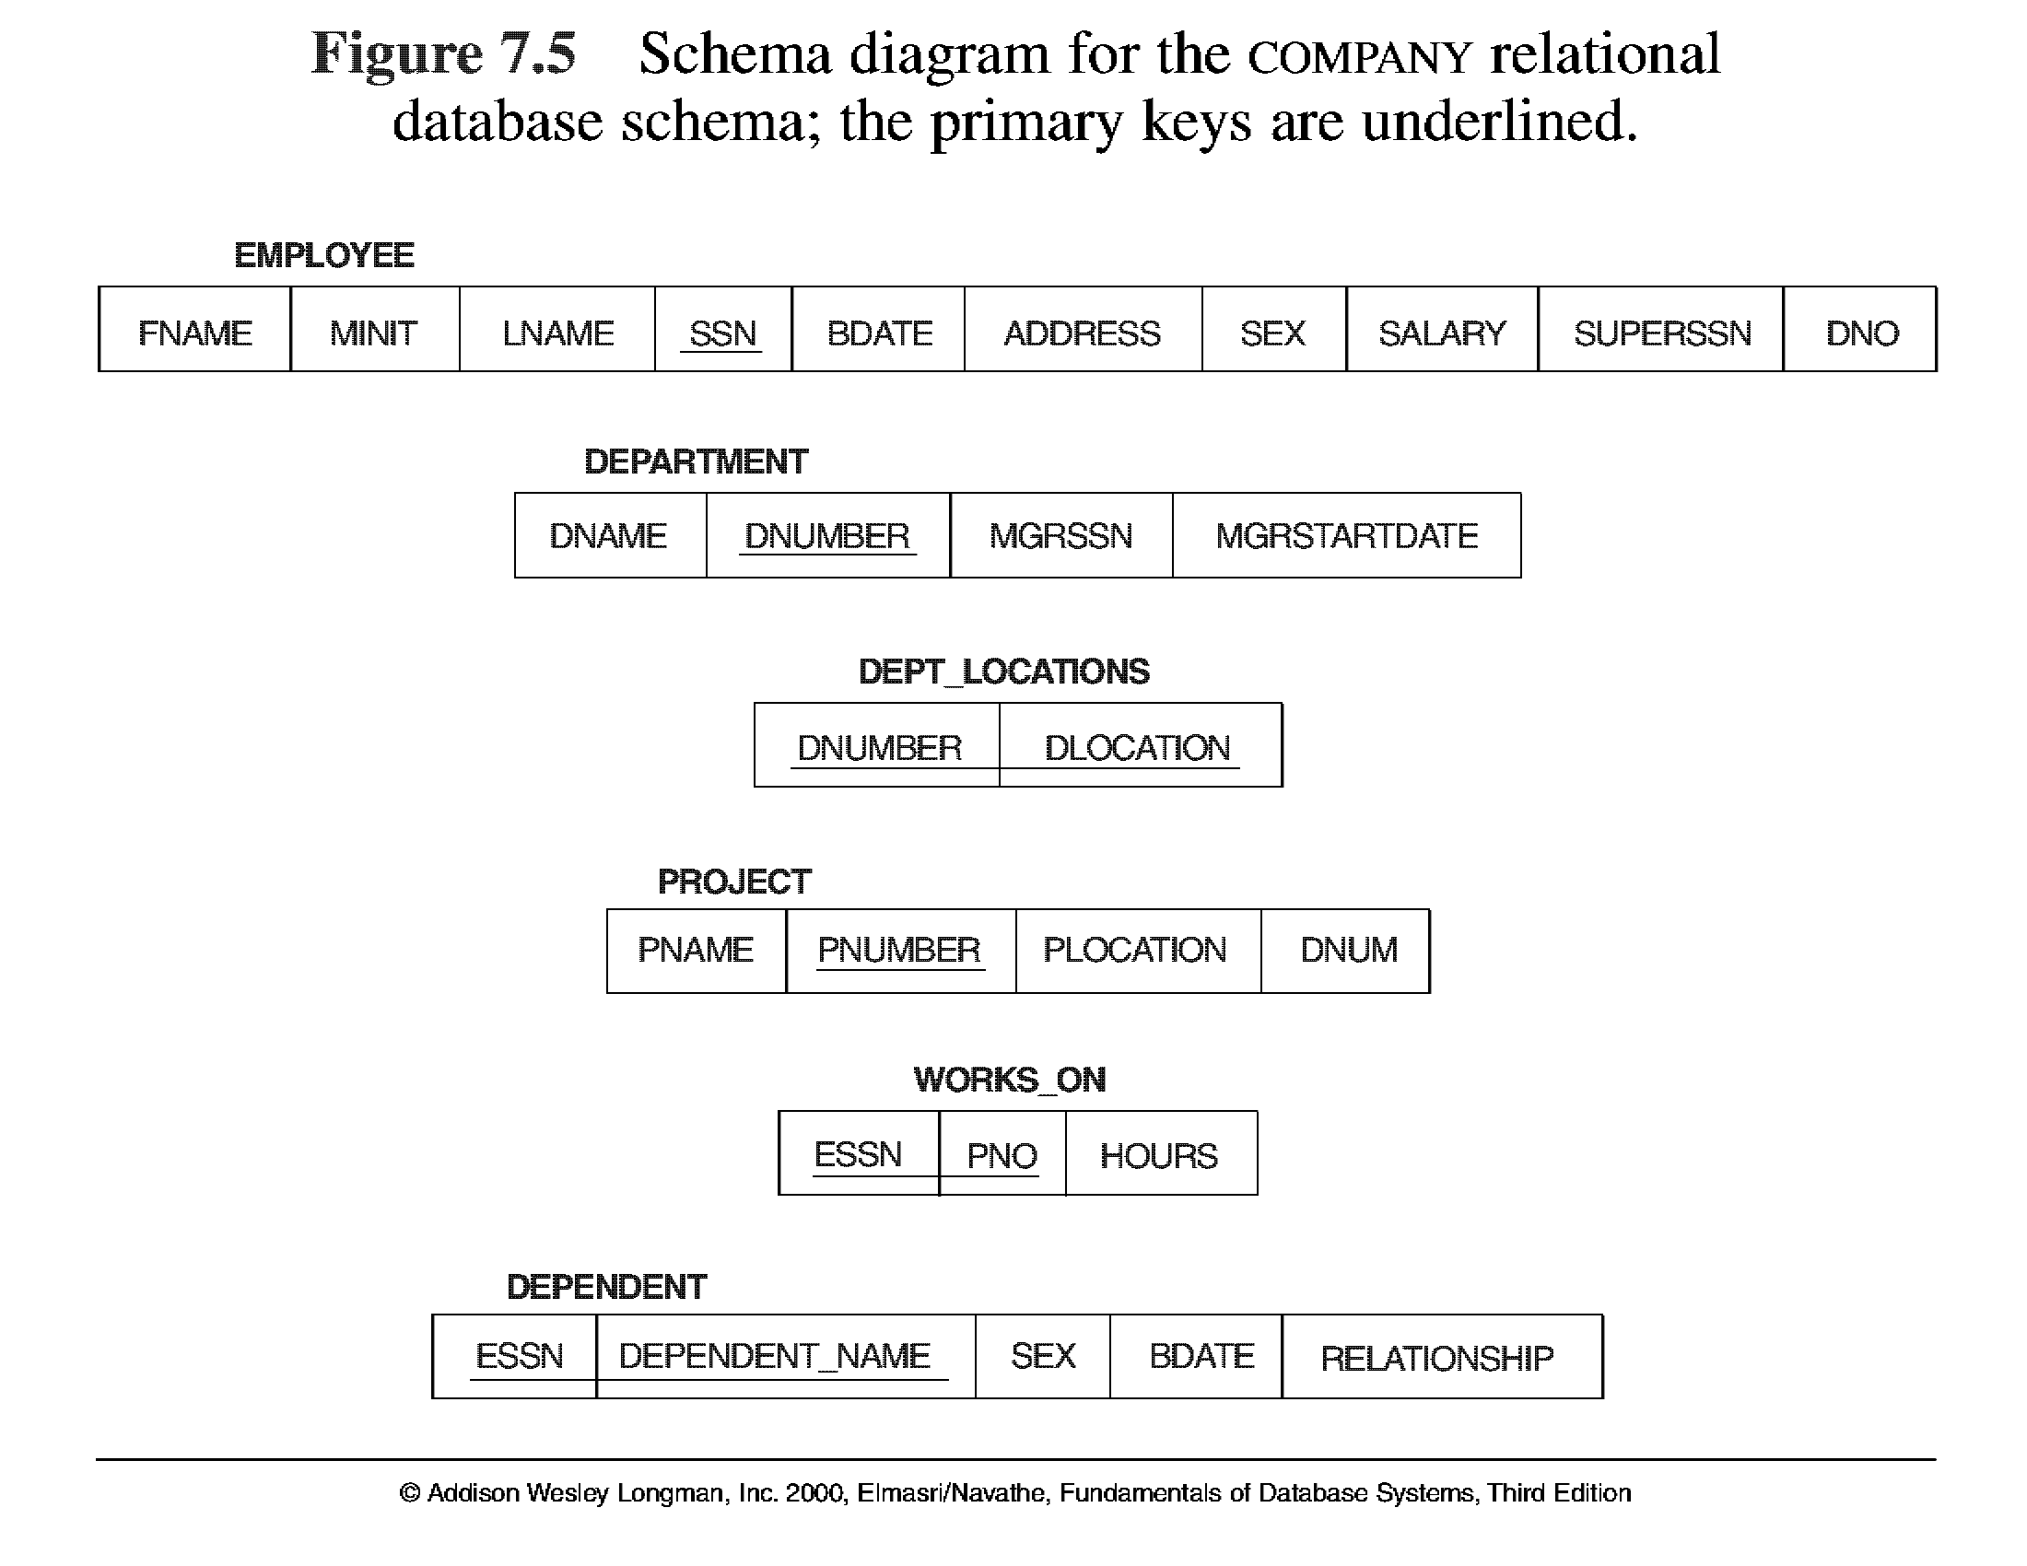
Database State for COMPANY
All examples discussed below refer to the COMPANY database shown here.

Slide 4
Relational Algebra
The basic set of operations for the relational model is known as the relational algebra. These operations enable a user to specify basic retrieval requests.
The result of a retrieval is a new relation, which may have been formed from one or more relations. The algebra operations thus produce new relations, which can be further manipulated using operations of the same algebra.
A sequence of relational algebra operations forms a relational algebra expression, whose result will also be a relation that represents the result of a database query (or retrieval request).

Slide 5
Unary Relational Operations
SELECT Operation
SELECT operation is used to select a subset of the tuples from a relation that satisfy a selection condition. It is a filter that keeps only those tuples that satisfy a qualifying condition – those satisfying the condition are selected while others are discarded.
Example: To select the EMPLOYEE tuples whose department number is four or those whose salary is greater than $30,000 the following notation is used:
σDNO = 4 (EMPLOYEE)
σSALARY > 30,000 (EMPLOYEE)
In general, the select operation is denoted by _{σ <selection condition>}(R) where the
symbol σ (sigma) is used to denote the select operator, and the selection condition is a Boolean expression specified on the attributes of relation R

Slide 6
Unary Relational Operations
SELECT Operation Properties
The SELECT operation σ _{<selection condition>}(R) produces a relation S that has the same schema as R
The SELECT operation σ is commutative; i.e.,
σ _{<condition1>}(σ _{< condition2>} ( R)) = σ _{<condition2>} (σ _{< condition1>} ( R))
A cascaded SELECT operation may be applied in any order; i.e.,
σ _{<condition1>}(σ _{< condition2>} (σ _{<condition3>} ( R))
= σ _{<condition2>} (σ _{< condition3>} (σ _{< condition1>} ( R)))
A cascaded SELECT operation may be replaced by a single selection with a conjunction of all the conditions; i.e.,
σ _{<condition1>}(σ _{< condition2>} (σ _{<condition3>} ( R))
= σ <condition1> AND < condition2> AND < condition3> ( R)))

Slide 7
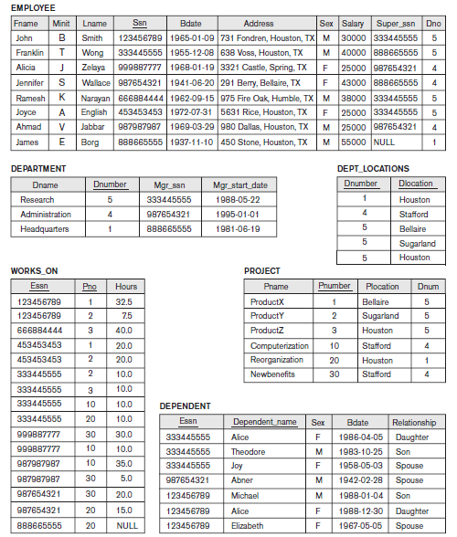

Slide 8
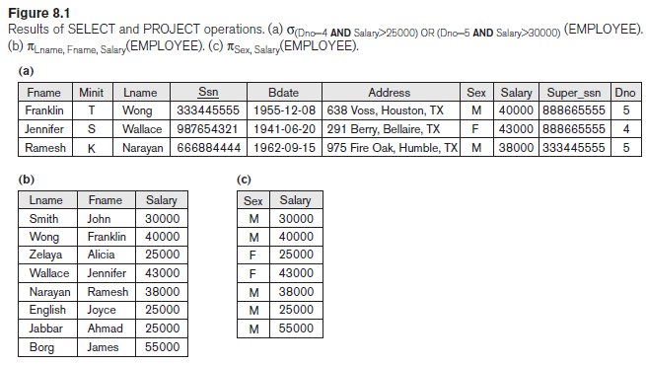

Slide 9
Unary Relational Operations (cont.)
PROJECT Operation
This operation selects certain columns from the table and discards the other columns. The PROJECT creates a vertical partitioning – one with the needed columns (attributes) containing results of the operation and other containing the discarded Columns.
Example: To list each employee’s first and last name and salary, the following is used:
π_{LNAME, FNAME,SALARY}(EMPLOYEE)
The general form of the project operation is π<attribute list>(R) where π (pi) is the symbol used to represent the project operation and <attribute list> is the desired list of attributes from the attributes of relation R.
The project operation removes any duplicate tuples, so the result of the project operation is a set of tuples and hence a valid relation.

Slide 10
Unary Relational Operations (cont.)
PROJECT Operation Properties
The number of tuples in the result of projection π _{<list>} (R) is always less or equal to the number of tuples in R.
If the list of attributes includes a key of R, then the number of tuples is equal to the number of tuples in R.
π _{<list1>} (π _{<list2>} (R) ) = π _{<list1>} (R) as long as <list2> contains the attributes in <list1>
It is noteworthy that commutativity does not hold on PROJECT.

Slide 12
Unary Relational Operations (cont.)
Rename Operation
We may want to apply several relational algebra operations one after the other. Either we can write the operations as a single relational algebra expression by nesting the operations, or we can apply one operation at a time and create intermediate result relations. In the latter case, we must give names to the relations that hold the intermediate results.
Example: To retrieve the first name, last name, and salary of all employees who work in department number 5, we must apply a select and a project operation. We can write a single relational algebra expression as follows:
π_{FNAME, LNAME, SALARY}(σ _{DNO=5}(EMPLOYEE))
OR We can explicitly show the sequence of operations, giving a name to each intermediate relation:
DEP5_EMPS ← σ _{DNO=5}(EMPLOYEE)
RESULT ← π _{FNAME, LNAME, SALARY} (DEP5_EMPS)

Slide 13
Unary Relational Operations (cont.)
Rename Operation (cont.)
The rename operator is ρ (rho)
The general Rename operation can be expressed by any of the following forms:
ρ _{S (B1, B2, …, Bn )} ( R) is a renamed relation S based on R with column names B₁, B₂,…..B_{n}.
ρ _{S} ( R) is a renamed relation S based on R (which does not specify column names).
ρ _{(B1, B2, …, Bn )} ( R) is a renamed relation with column names B₁, B₂, …..B_{n} which does not specify a new relation name.

Slide 14
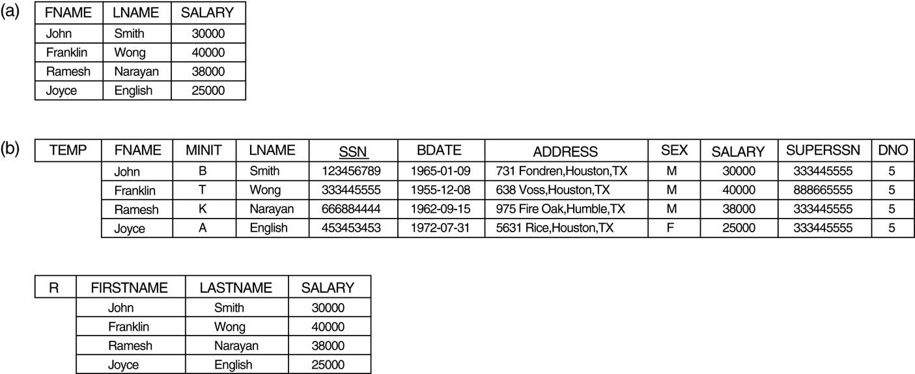
Results of a sequence of operations. (a) π_{FNAME, LNAME, SALARY} (σ_{DNO=5}(EMPLOYEE)). (b) Using intermediate relations and renaming of attributes.

Slide 15
Relational Algebra Operations From Set Theory
UNION Operation
The result of this operation, denoted by R ∪ S, is a relation that includes all tuples that are either in R or in S or in both R and S. Duplicate tuples are eliminated.
Example: To retrieve the social security numbers of all employees who either work in department 5 or directly supervise an employee who works in department 5, we can use the union operation as follows:
DEP5_EMPS ← σ_{DNO=5} (EMPLOYEE)
RESULT1 ← π _{SSN}(DEP5_EMPS)
RESULT2(SSN) ← π _{SUPERSSN}(DEP5_EMPS)
RESULT ← RESULT1 ∪ RESULT2
The union operation produces the tuples that are in either RESULT1 or RESULT2 or both. The two operands must be “type compatible”.

Slide 17
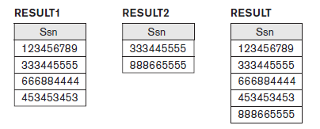

Slide 18
Relational Algebra Operations From Set Theory
Type Compatibility
The operand relations R₁(A₁, A₂, ..., A_{n}) and R₂(B₁, B₂, ..., B_{n}) must have the same number of attributes, and the domains of corresponding attributes must be compatible; that is, dom(A_{i})=dom(B_{i}) for i=1, 2, ..., n.
The resulting relation for R₁∪R₂,R₁ ∩ R₂, or R₁-R₂ has the same attribute names as the first operand relation R1 (by convention).

Slide 19
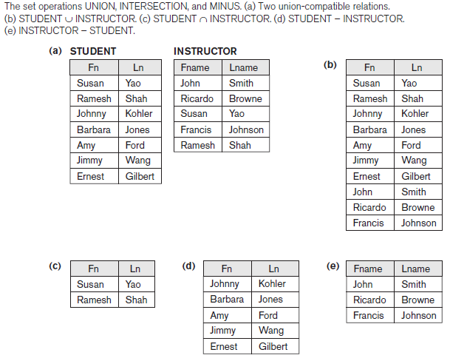

Slide 20
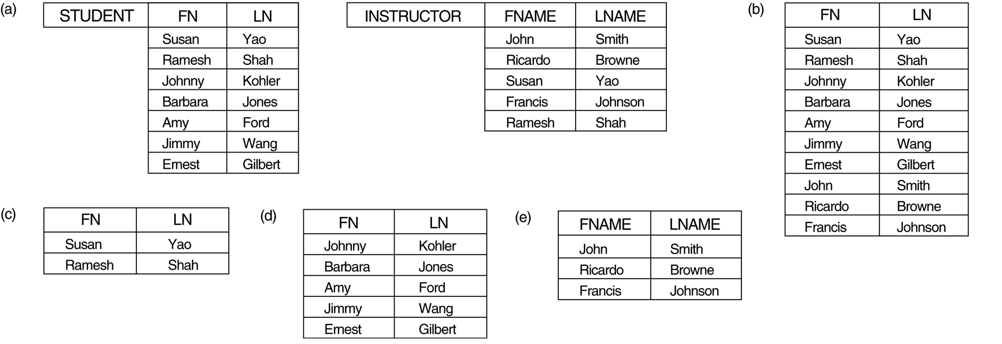
Relational Algebra Operations From Set Theory (cont.)
INTERSECTION OPERATION
The result of this operation, denoted by R ∩ S, is a relation that includes all tuples that are in both R and S. The two operands must be "type compatible"
Example: The result of the intersection operation (figure below) includes only those who are both students and instructors.
STUDENT ∩ INSTRUCTOR

Slide 21
Relational Algebra Operations From Set Theory (cont.)
Set Difference (or MINUS) Operation
The result of this operation, denoted by R - S, is a relation that includes all tuples that are in R but not in S. The two operands must be "type compatible”.
Example: The figure shows the names of students who are not instructors, and the names of instructors who are not students.
STUDENT-INSTRUCTOR
INSTRUCTOR-STUDENT

Slide 22
Relational Algebra Operations From Set Theory (cont.)
Notice that both union and intersection are commutative operations; that is
R ∪ S = S ∪ R, and R ∩ S = S ∩ R
Both union and intersection can be treated as n-ary operations applicable to any number of relations as both are associative operations; that is
R ∪ (S ∪ T) = (R ∪ S) ∪ T, and (R ∩ S) ∩ T = R ∩ (S ∩ T)
The minus operation is not commutative; that is, in general
R - S ≠ S – R

Slide 23
Relational Algebra Operations From Set Theory (cont.)
CARTESIAN (or cross product) Operation
This operation is used to combine tuples from two relations in a combinatorial fashion. In general, the result of R(A₁, A₂, . . ., A_{n}) x S(B₁, B₂, . . ., B_{m}) is a relation Q with degree n + m attributes Q(A₁, A₂, . . ., A_{n}, B₁, B₂, . . ., B_{m}), in that order. The resulting relation Q has one tuple for each combination of tuples—one from R and one from S.
Hence, if R has n_{R} tuples (denoted as |R| = n_{R} ), and S has n_{S} tuples, then
| R x S | will have n_{R} * n_{S} tuples.
The two operands do NOT have to be "type compatible”
Example:
FEMALE_EMPS ← σ _{SEX=’F’}(EMPLOYEE)
EMPNAMES ← π _{FNAME, LNAME, SSN} (FEMALE_EMPS)
EMP_DEPENDENTS ← EMPNAMES x DEPENDENT

Slide 25
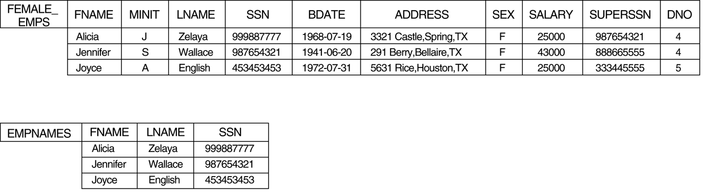
The CARTESIAN PRODUCT (CROSS PRODUCT) operation.

Slide 26
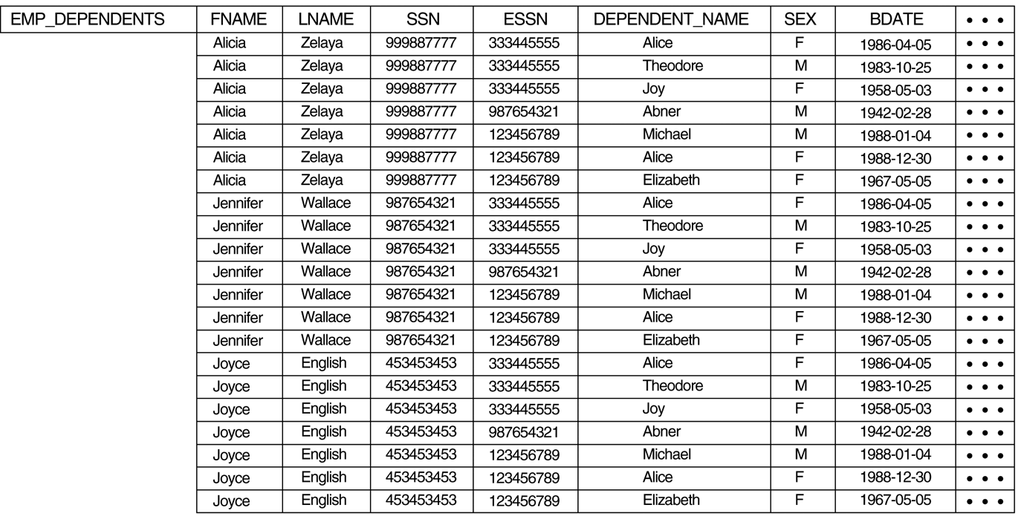
The CARTESIAN PRODUCT (CROSS PRODUCT) operation.

Slide 27

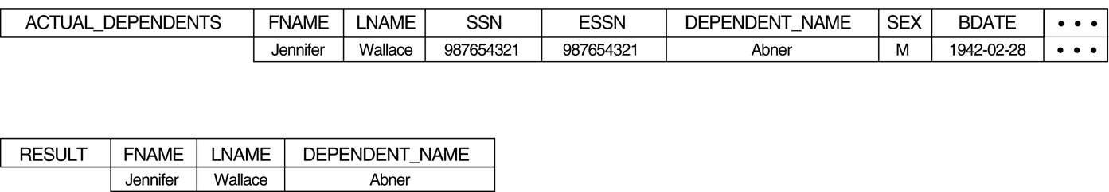
The CARTESIAN PRODUCT (CROSS PRODUCT) operation.

